Slide 1
Capstone Project – Dec’2016 Batch
Sentiment Analysis of
Book Reviews
Presentation by
Abhinandan Nuli | Hrishikesh Bhatkhande | Mohit Sharma | Vivek Chutke
7-Oct-2017
Notes:
My notes

Slide 2
Agenda
1 | Overall Status
2 | Data Exploration & Data Processing
3 | Sentiment Classifier Model Implementation Results
4 | Analysis of Results & Optimization
5 | Components & Deliverables
6 | Next Steps
7 | Appendix

Slide 3
Background
Project Title
Sentiment Analysis of Book Reviews
Input Data Source
Online book reviews of 8 Amazon books that contain rating on the scale of 1 to 5 and the text of actual review
Project Goal
Create a machine learning model to extract the sentiment out of the actual review based on the presence and frequency of positive and negative words in the review Use bag of words and Word-to-vec approaches to extract the sentiment and context Use Classification model such as Naive Bayes to train, validate and test the tokenized and cleaned up review data along with the actual ratings.
Project Team
Vivek Chutke Mohit Sharma Hrishikesh Bhatkhande Abhinandan Nuli
Technology & Software
Programming Language – R, Python Software – R Studio

Slide 4
Workflow
Input Data
Obtaining Data
Data file Sources | Amazon book reviews crawled from the net using multiple technologies – Amazon APIs, Selenium
Data file Features | - Reviews of 8 books crawled - Files are provided in .csv format, containing the reviews within the html tags
Data Exploration
Data Preparation / Curation
Model Creation
Model Validation
Model Implementation
Optimization

Slide 5
Last Status – 12-Aug-2017
Current Stage
100%
Model Creation & Model Validation
Obtaining Data
Overall Schedule RYG Status
100%
Data Exploration
80%
Data Preparation / Curation
50%
30%
0%
Model Creation
Model Validation
Model Implementation
0%
Optimization

Slide 6
Current Status – 7-Oct-2017
Current Stage
100%
Model Optimization
Obtaining Data
Overall Schedule RYG Status
100%
Data Exploration
100%
Data Preparation / Curation
100%
100%
100%
Model Creation
Model Validation
Model Implementation
95%
Optimization

Slide 7
Data Exploration
Data Exploration
Assessment of significance of all data columns and removal of unwanted data columns
Sanity checks of the important data (missing values, NA’s etc.)
Removal of html tags from the review text
Comparison of distribution of ratings across all 8 book reviews
Assessment of frequency distribution of reviews based on review lengths and removal of extremes (especially extremely large reviews)
Identifying data for creating a prototype model (relatively uniform distribution across reviews preferred)

Slide 8
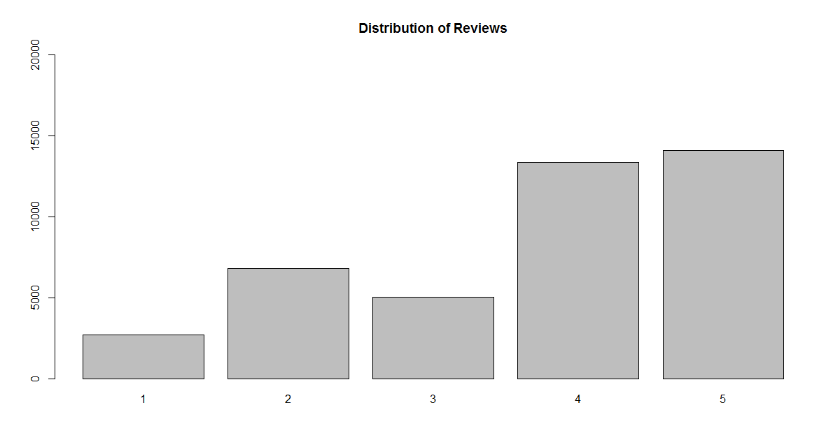
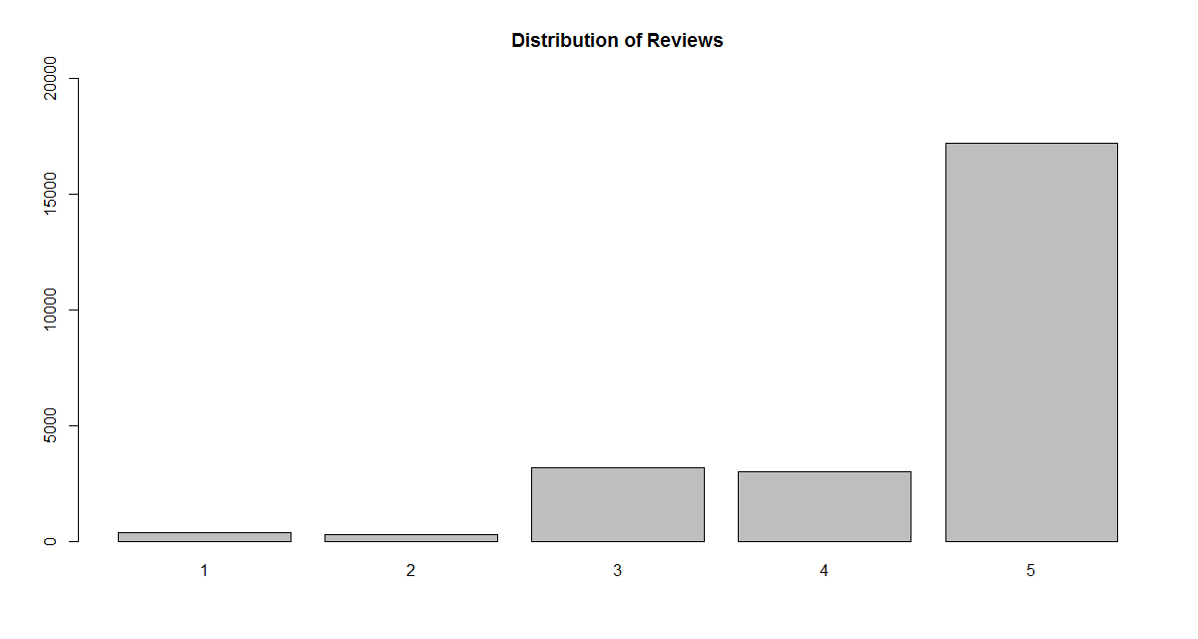
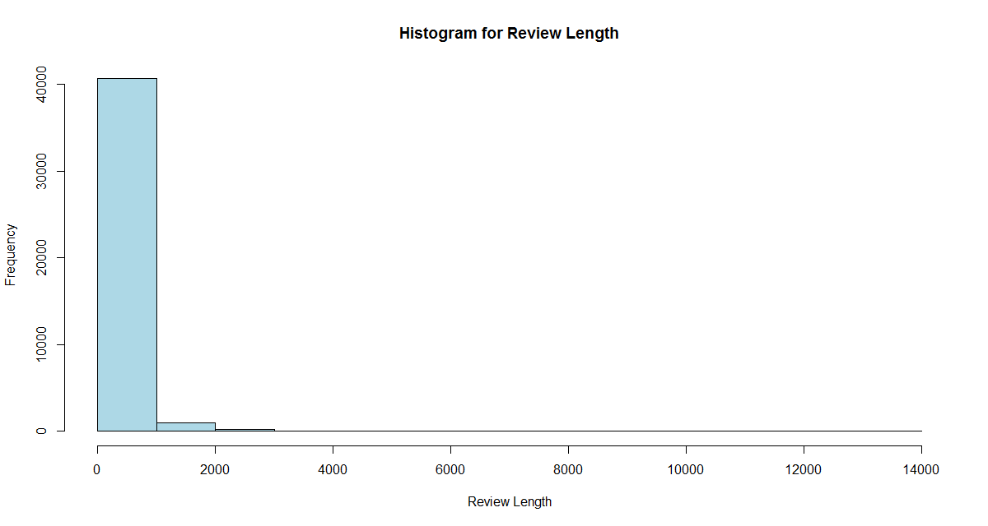
Data Exploration
Comparison of Distribution of Reviews based on the ratings for “Gone Girl” on the left and “Hunger Games” on the right. “Gone Girl” has more suitable data for training the model as the distribution is more uniform than in case of “Hunger Games”
Most of the reviews in “Gone Girl” are less than 1000 characters. Omitting the ones >1000 characters helps maintain the complexity of test processing (bag of words) and is not likely to impact the model training

Slide 9
Data Processing
Data Pre-processing
Applying NLP techniques to pre-process the data – tokenization, whitespace removal, lowercasing, removal of punctuation, removal of numbers
Converting negative contractions to their expanded forms (e.g. isn’t = is not)
Removing stop-words – common words that do not define the sentiment (e.g., “a”, “if”, “am”, etc.)
Vectorization of words (Corpus) and Generation of Document-Term matrix
Sentiment Extraction
Compare the bag of words with a standard pre-defined list of positive and negative words
Several R packages were compared to check which fits best for our dataset. Examples – TM, Quanteda

Slide 10
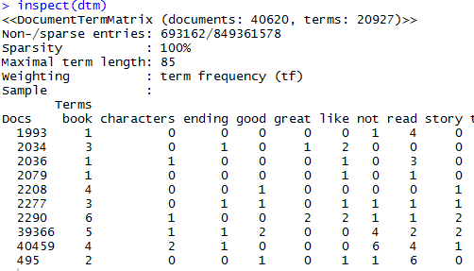
Data Processing
Sample output of Document Term Matrix
Docs – Each review in the dataset (book)
Terms – Tokenized words
Numbers in each cell (row, column) indicate the frequency of that term occurring in the review. This plays a crucial role in training the Classification algorithm.

Slide 11
Data Processing
Handling The NOT’s
When a word with a positive or negative sentiment is preceded by negating words, then the sentiment of that group of words needs to be reversed.
For example, the word “good” has a positive sentiment. But the group of words “Not a good book” should indicate negative sentiment.
Examples of some cases that we have handled –
Type | Example | Expected Sentiment
Single Not | “Not a good book” | Negative for the word “good”
Not with and and/or | “Does not make me feel happy or joyful” | Negative for both “happy” and “joyful”
Two not’s | “It is not that it’s not a good book” | Positive for the word “good”
Negative verbs | The book fails to impress | Negative for the word “impress”

Slide 12
Sentiment Extraction
Sentiment Extraction
Two approaches used to extract sentiment of words in R –
Comparison with a pre-defined list of positive and negative words
Using get_nrc_sentiment function from the syuzhet package in R
For every review in the dataset, a net score of the sentiment of the review based on individual scores for words and groups of words in the review.
Score < 0 indicates there are more negative words than positive words
Score > 0 indicates there are more positive words than negative words
Score = 0 indicates that the positive and negative words are same in number

Slide 13
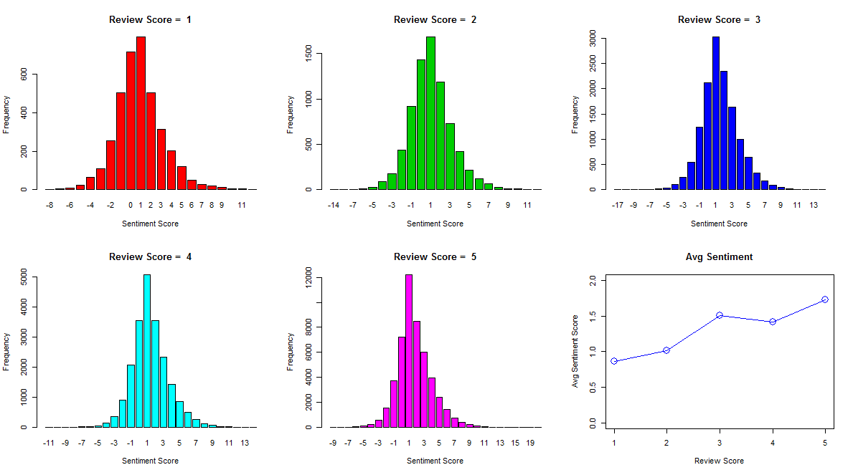
Sentiment Extraction
Results
Distribution of Sentiment Score for each Review-Score

Slide 14
Sentiment Extraction
Comments on the skewness (or lack of it) of the Sentiment Score
The distribution of Sentiment Scores does not show the expected skewness
That is, for Review Score 1, we expect the Sentiment Scores to be skewed on the left (indicating more number of negative Sentiment Scores).
Similarly, for Review Score 5, we expect more Sentiment Scores on the right-side of the distribution.

Slide 15
Sentiment Extraction
Observations about Review Scores given by the users
Review | Review Text | Sentiment
1 | i found this novel engaging as both a mystery and a psychological study. in fact, i can not think of any element which was in the least disappointing. the characters are well drawn out and believable and the storyline, although surprising and unique, is made believable by gillian flynn's expert storytelling. i plan on reading more of ms flynn's work which i hope is as engaging as this novel. | 12
5 | what was all the hype about? that was the worst book i've ever read. stupid stupid stupid. they both spend the entire book whining whining whining! the ending is so dumb i still feel like i missed some joke. | -9
5 | ii feel cheated and ripped off by this book. the characters are despicable, and the cheap plot trick the author uses makes the first half of the book pointless. i did not like this book and would not recommend it to anyone. | -8
5 | i just could not get into this novel. it was not interesting from the start, and got worst as each page turned. the subject matter did not entertain, and the conclusion was awful. sorry about such a negative review, but this book disappointed.. | -8
2 | great adventure, survival story! i loved the convincing science and enjoyed all the characters. i was completely absorbed from beginning to end. i highly recommend this book to anyone who enjoys science, sci-fi, survival, adventure and well developed, humorous characters. this story has all the bells &amp; whistles. | 13

Slide 16
Sentiment Extraction
Examples of Sentiments captured not matching the intended sentiment
Review | Review Text | Sentiment
5 | gillian flynn's best seller depicts a marriage gone terribly wrong that ignites on its fifth anniversary (july , ) from a simmering, sinister set of dire circumstances into a criminal investigation. diabolical schemes of revenge and spousal annihilation explode this private nightmare into a national feeding frenzy by the media. the pages turn and the suspense mounts. a great read! | -8
4 | hated the ending!!!!' hate the end. hate the ending. hate the end. hate. hate hate hate hate hate!!!! the end | -10
Summary
The mismatch between the review-score and the actual review is greater than the examples of sentiments not correctly captured by the code.
In order to generate a machine learning model to relatively accurately predict the sentiment by training the model with available data, a document-term-frequency matrix needs to be used along with combination of the review score and extracted sentiment score in the machine learning model.

Slide 17
Model Creation
Model Creation
Naive Bayes model to classify the sentiments as – “Positive”, “Neutral”, “Negative”
Approach –
Create a prototype model for the book/books selected as the best fit for training in the data-exploration phase
Validate and test the model using on the same dataset
Test the model on other books
Measure the accuracy of the results
Re-train the model based on observations until the accuracy improves
The various cases explored and executed as part of model creation are presented in the next slides

Slide 18
Model Implementation
Case 1 : Smaller Subset of Data |  |  | Total #
Input Data Used – | Reviews in 4 out of 8 books that have <= 60 characters |  | 19825
Training Data – | 80% of Input data |  | 15860
Testing Data – | 20% of Input Data |  | 3965
 | Actuals (Derived Sentiment Levels using Sentiment Extractor Module)
Predictions (Sentiment Levels Predicted by model) | -1 | 0 | 1 | Total
-1 | 216 | 61 | 5 | 282
0 | 123 | 394 | 150 | 667
1 | 53 | 393 | 2570 | 3016
Total | 392 | 848 | 2725 | 3965
Prediction Accuracy | 55.10% | 46.46% | 94.31% | 80.20%

Slide 19
Model Implementation
Case 2 : Larger Subset of Data |  |  | Total #
Input Data Used – | Reviews in 4 out of 8 books that have <= 400 characters |  | 95584
Training Data – | 80% of Input data |  | 76467
Testing Data – | 20% of Input Data |  | 19117
 | Actuals (Derived Sentiment Levels using Sentiment Extractor Module)
Predictions (Sentiment Levels Predicted by model) | -1 | 0 | 1 | Total
-1 | 1416 | 546 | 674 | 2636
0 | 899 | 1255 | 1278 | 3432
1 | 590 | 1206 | 11253 | 13049
Total | 2905 | 3007 | 13205 | 19117
Prediction Accuracy | 48.74% | 41.74% | 85.22% | 72.84%

Slide 20
Model Implementation
Case 3a : Testing with different book |  |  | Total #
Input Data Used – | Reviews in 5 out of 8 books that have <= 100 characters |  | 34412
Training Data – | 4 out of 5 books |  | 29871
Testing Data – | The 5th book (EL James) |  | 4541
 | Actuals (Derived Sentiment Levels using Sentiment Extractor Module)
Predictions (Sentiment Levels Predicted by model) | -1 | 0 | 1 | Total
-1 | 426 | 121 | 59 | 606
0 | 222 | 356 | 216 | 794
1 | 136 | 553 | 2452 | 3141
Total | 784 | 1030 | 2727 | 4541
Prediction Accuracy | 54.34% | 34.56% | 89.92% | 71.22%

Slide 21
Model Implementation
Case 3b : Testing with different book |  |  | Total #
Input Data Used – | Reviews in 5 out of 8 books that have <= 100 characters |  | 36145
Training Data – | 4 out of 5 books |  | 29871
Testing Data – | The 5th book (John Green) |  | 6274
 | Actuals (Derived Sentiment Levels using Sentiment Extractor Module)
Predictions (Sentiment Levels Predicted by model) | -1 | 0 | 1 | Total
-1 | 146 | 68 | 29 | 243
0 | 153 | 332 | 262 | 747
1 | 122 | 737 | 4425 | 5284
Total | 421 | 1137 | 4716 | 6274
Prediction Accuracy | 34.68% | 29.20% | 93.83% | 78.15%

Slide 22
Model Implementation
Case 3c : Testing with different book |  |  | Total #
Input Data Used – | Reviews in 5 out of 8 books that have <= 100 characters |  | 47506
Training Data – | 4 out of 5 books |  | 29871
Testing Data – | The 5th book (Paula Hawkins) |  | 17635
 | Actuals (Derived Sentiment Levels using Sentiment Extractor Module)
Predictions (Sentiment Levels Predicted by model) | -1 | 0 | 1 | Total
-1 | 1500 | 481 | 165 | 2146
0 | 948 | 2105 | 994 | 4047
1 | 267 | 1666 | 9509 | 11442
Total | 2715 | 4252 | 10668 | 17635
Prediction Accuracy | 55.25% | 49.51% | 89.14% | 74.36%

Slide 23
Model Implementation
Case 3d : Testing with different book |  |  | Total #
Input Data Used – | Reviews in 5 out of 8 books that have <= 100 characters |  | 32104
Training Data – | 4 out of 5 books |  | 29871
Testing Data – | The 5th book (Suzanne Collins) |  | 2233
 | Actuals (Derived Sentiment Levels using Sentiment Extractor Module)
Predictions (Sentiment Levels Predicted by model) | -1 | 0 | 1 | Total
-1 | 41 | 12 | 9 | 62
0 | 41 | 126 | 83 | 250
1 | 43 | 199 | 1679 | 1921
Total | 125 | 337 | 1771 | 2233
Prediction Accuracy | 32.80% | 37.39% | 94.81% | 82.67%

Slide 24
Model Implementation
Summary of usage of Review Data from all the books |  | Case 1 |  |  | Case 2 |  |  | Case 3a |  |  | Case 3b |  |  | Case 3c |  |  | Case 3d
Andy-Weir-The-Martian |  | 80 % | 20 % |  | 80 % | 20 % |  | 100 % |  |  | 100 % |  |  | 100 % |  |  | 100 %
Donna-Tartt-The-Goldfinch
Fillian_Flynn-Gone_Girl
Laura-Hillenbrand-Unbroken
EL-James-Fifty-Shades-of-Grey |  |  |  |  |  |  |  | 100%
John-Green-The-Fault-in-our-Stars |  |  |  |  |  |  |  |  |  |  | 100%
Paula_Hawkins-The-Girl-On-The-Train |  |  |  |  |  |  |  |  |  |  |  |  |  | 100%
Suzanne-Collins-The-Hunger-Games |  |  |  |  |  |  |  |  |  |  |  |  |  |  |  |  | 100%
Review Length Limit |  | 60 |  |  | 400 |  |  | 100 |  |  | 100 |  |  | 100 |  |  | 100
 | Training
 | Testing

Slide 25
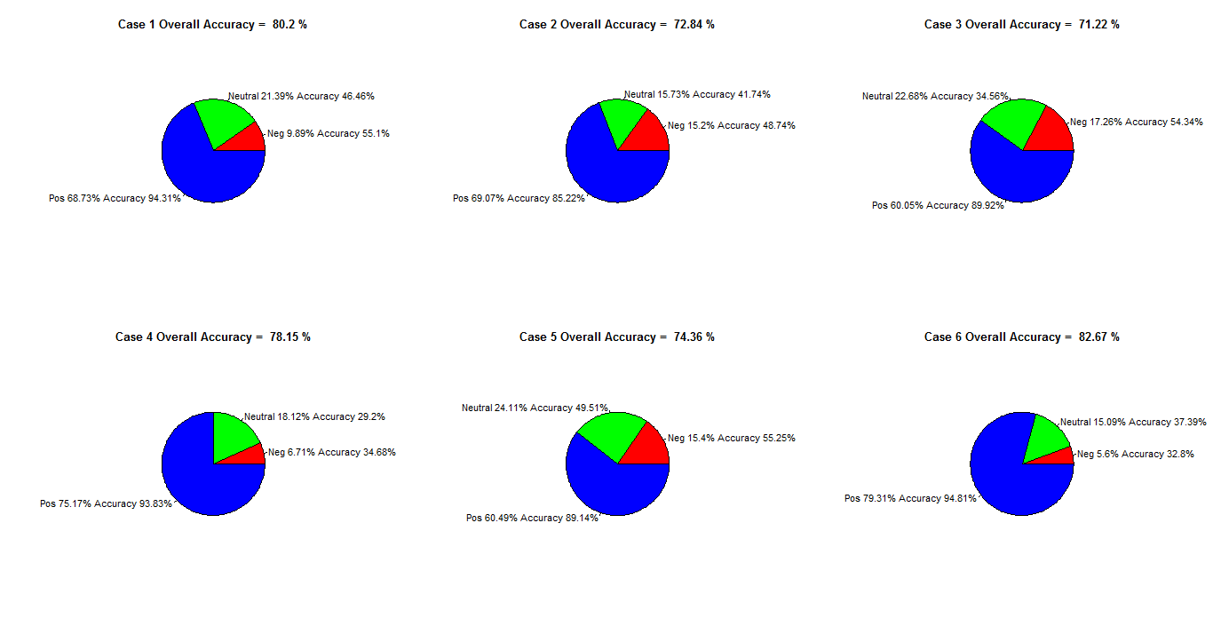
Analysis of Results
Study of effect of disproportionate distribution of positive, neutral & negative sentiments

Slide 26
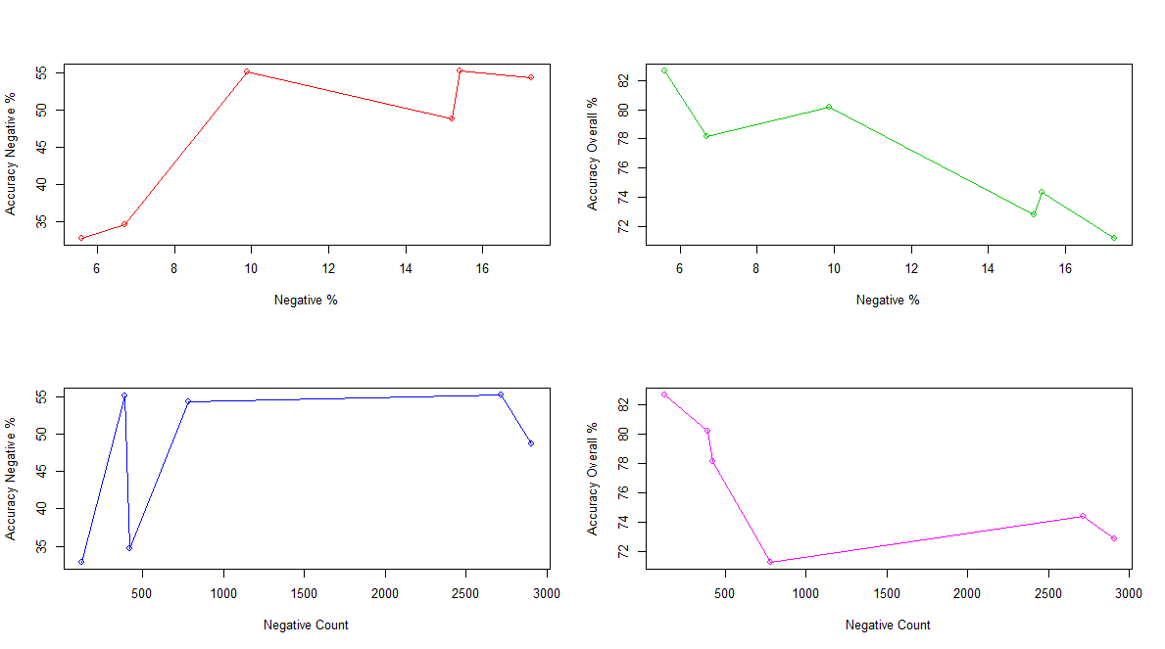
Analysis of Results
Study of effect of disproportionate distribution of positive, neutral & negative sentiments
Negative : Effect of Percentage and Counts of Negative Reviews on Negative Prediction Accuracy & Overall Accuracy

Slide 27
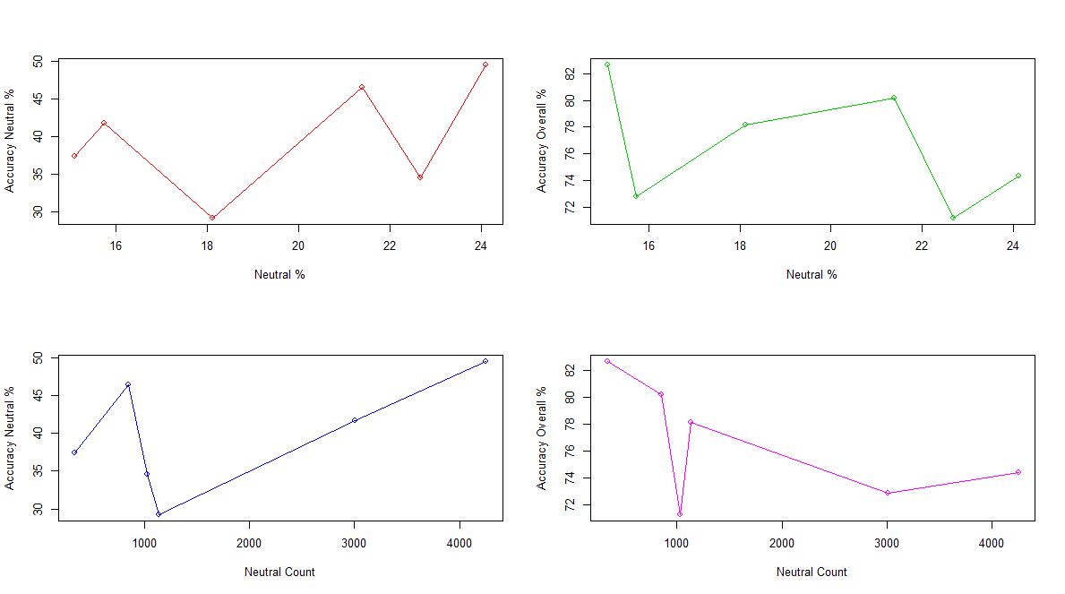
Analysis of Results
Study of effect of disproportionate distribution of positive, neutral & negative sentiments
Neutral : Effect of Percentage and Counts of Neutral Reviews on Neutral Prediction Accuracy & Overall Accuracy

Slide 28
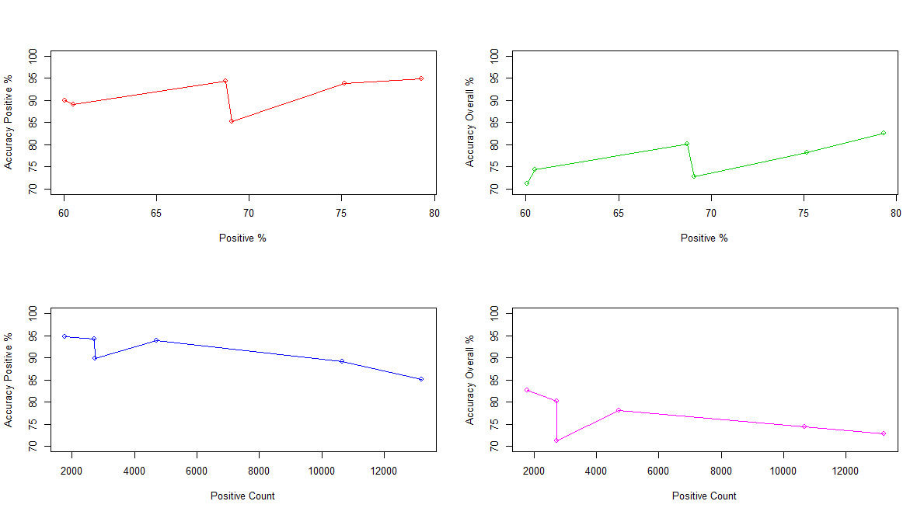
Analysis of Results
Study of effect of disproportionate distribution of positive, neutral & negative sentiments
Positive : Effect of Percentage and Counts of Positive Reviews on Positive Prediction Accuracy & Overall Accuracy

Slide 29
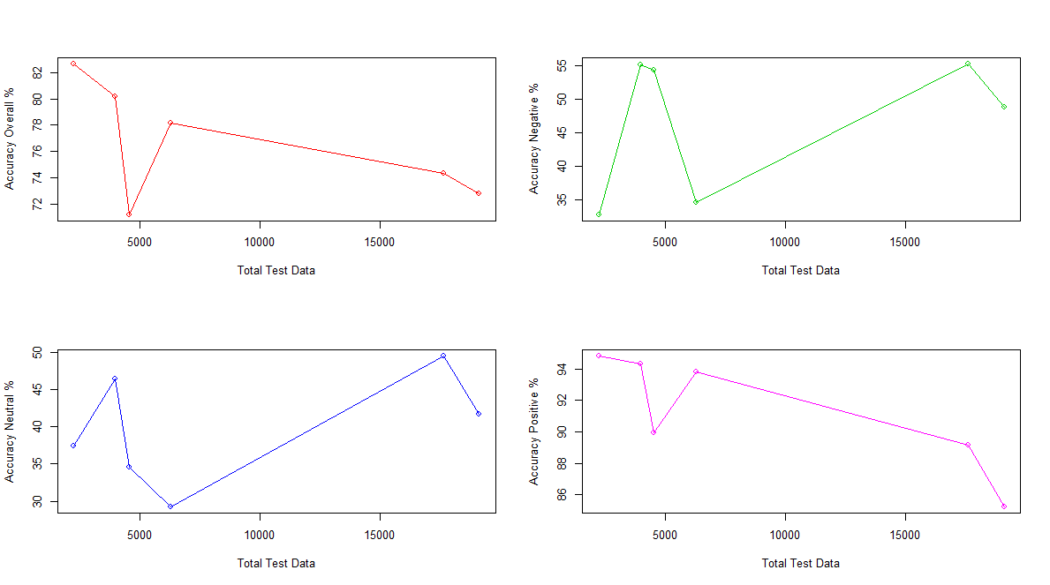
Analysis of Results
Impact of size of Test Data on Prediction Accuracy

Slide 30
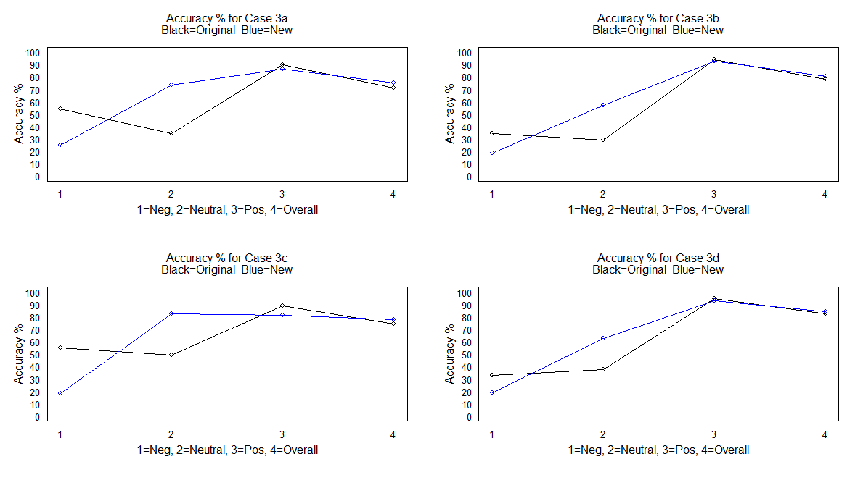
Optimization
Impact of improvisation in sentiment labeling logic on overall results

Slide 31
Further Optimization Areas
With regards to Machine Learning model
Improvement in the sentiment levels classification till the prediction accuracy results in the model validation phase attain high values.
Optimization of the number of sentiment levels (levels of the output variable).
We have observed that the Naïve Bayes classifier does not work at its best when the number of classification levels is very high.
Use other classification models such as SVM, MAXENT, RF, Decision Tree to study the effect on this particular dataset and choose the model that works the best.
With regards to Text Data Processing
Classifying the data into triplets and using bigrams and n-grams instead of using single word occurrences and their frequencies

Slide 32
Further Optimization Areas
Applying NLP techniques to bifurcate sentences into more meaningful data
Further improvement in handling of the NOT’s
With regards to overall functioning and performance
Improving execution time and performance (currently the code takes very high time to execute and hence adding any more complexity will be detrimental to the performance)
Comparison of results across R and Python
Applying Deep Learning techniques for better results

Slide 33
Conclusion
Conclusion
The Naïve Bayes based sentiment classifier built in this project gives satisfactory results and provides a base for further optimization.
Sentiment labeling (defining the classification levels of the output) plays a crucial role in accuracy of the model.
Selection of the classification model for better results and higher performance is key for developing a prototype model.

Slide 34
Components & Deliverables
Code (Modules)
Module 1 – module for data exploration, pre-processing, handing NOT’s and extracting overall sentiment
Output Files / Plots (for each case executed end-to-end)
Module 1 Output File 1 – Review data appended with Sentiment value for each review
Module 2 – this module labels the sentiment values in desired number of levels, generates DTM and implements Naïve Bayes classification algorithm
Module 3 – provides analysis of results of implementation of Machine Learning model
Module 2 Output File 1 – Review data appended with DTM
Module 2 Output File 2 – Test dataset appended with the predicted sentiment
Module 2 Output File 3 – Summary of Prediction vs Actual Sentiments for test data
Module 3 Various Plots (key sample plots have been depicted on various slides)
Project Documentation
Project Proposal Document
Project Proposal Presentation
Project Intermediate Status Report – Aug-2017
Project Final Status Report – Oct-2017

Slide 35
Next Steps
Complete Project Status Presentation (ETA : 7-Oct)
Complete Project Delivery and Final Project Report (ETA : 7-Oct)
Incorporate changes based on feedback provided during Review Session (ETA : 14-Oct)

Slide 36
Appendix : Sample Example
Sample Example for DTM and Naïve Bayes Model
Step 1 - Data Processing
Original Data
ID | Review Score | Review Text
1 | 2 | Start of the book is not bad. End of the book is bad.
2 | 1 | Pathetic book
3 | 4 | This is an amazing book. Liked it!
After Data-Preprocessing, Handling NOT’s and Removing Stop-words
ID | Review Score | Review Text
1 | 2 | start book !bad end book bad
2 | 1 | pathetic book
3 | 4 | amazing book liked

Slide 37
Appendix : Sample Example
Sample Example for DTM and Naïve Bayes Model
Step 1 - Data Processing
Original Data
ID | Review Score | Review Text
1 | 2 | Start of the book is not bad. End of the book is bad.
2 | 1 | Pathetic book
3 | 4 | This is an amazing book. Liked it!
After Data-Preprocessing, Handling NOT’s and Removing Stop-words
ID | Review Score | Review Text
1 | 2 | start book !bad end book bad
2 | 1 | pathetic book
3 | 4 | amazing book liked
Modified word to indicate negation of original sentiment

Slide 38
Appendix : Sample Example
Sample Example for DTM and Naïve Bayes Model
Step 2 – Derive Review Sentiment
Processed Review Data
ID | Review Score | Review Text
1 | 2 | start book !bad end book bad
2 | 1 | pathetic book
3 | 4 | amazing book liked
Processed Review Data with Sentiments
ID | Review Score | Review Text | Sentiment Score | Sentiment Level
1 | 2 | start book !bad end book bad | 0 | Neutral
2 | 1 | pathetic book | -1 | Negative
3 | 4 | amazing book liked | 2 | Positive

Slide 39
Appendix : Sample Example
Sample Example for DTM and Naïve Bayes Model
Step 3 – Generate DTM
Processed Review Data
ID | Review Score | Review Text
1 | 2 | start book !bad end book bad
2 | 1 | pathetic book
3 | 4 | amazing book liked
DTM
 | start | book | !bad | end | bad | pathetic | amazing | liked
1 | 1 | 2 | 1 | 1 | 1
2 |  | 1 |  |  |  | 1
3 |  | 1 |  |  |  |  | 1 | 1

Slide 40
Appendix : Sample Example
Sample Example for DTM and Naïve Bayes Model
Step 4 – Modify DTM Frequencies according to Sentiment of the Term
DTM before modification
 | start | book | !bad | end | bad | pathetic | amazing | liked
1 | 1 | 2 | 1 | 1 | 1
2 |  | 1 |  |  |  | 1
3 |  | 1 |  |  |  |  | 1 | 1
Modified DTM :- x = (wordSentiment*10 + 20) * x
 | start | book | !bad | end | bad | pathetic | amazing | liked
1 | 20 | 40 | 30 | 20 | 10
2 |  | 20 |  |  |  | 10
3 |  | 20 |  |  |  |  | 30 | 30

Slide 41
Appendix : Sample Example
Sample Example for DTM and Naïve Bayes Model
Step 5 – Train Naïve Bayes using DTM and Review Score as input
Naïve Bayes Inputs
Output (Class)
Modified DTM
 | start | book | !bad | end | bad | pathetic | amazing | liked
1 | 20 | 40 | 30 | 20 | 10
2 |  | 20 |  |  |  | 10
3 |  | 20 |  |  |  |  | 30 | 30
Review Score
2
1
4
Sentiment Level
Neutral
Negative
Positive

Slide 42

Questions

